Slide 1


COLOUR SPACE
RGB

Slide 2

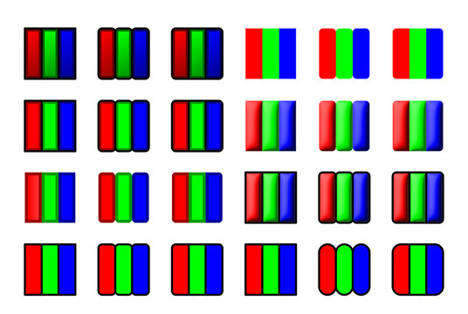
INTRODUCTION
Digital images are made up of tiny units called pixels, and each pixel in an RGB image contains three color values—Red, Green, and Blue. By adjusting the intensity (0–255) of these three components, each pixel displays a specific color. When millions of RGB pixels are combined, they form a complete, colorful image on digital screens, allowing for detailed and vibrant visual representations.

Slide 3
INTRODUCTION
The RGB color model is one of the most widely used color representation method in computer graphics. It use a color coordinate system with three primary colors:
R(red), G(green), B(blue)
Each primary color can take an intensity value ranging from 0(lowest) to 1(highest). Mixing these three primary colors at different intensity levels produces a variety of colors. The collection of all the colors obtained by such a linear combination of red, green and blue forms the cube shaped RGB color space.

Slide 4

TOPIC 1
COLOUR CUBE

Slide 5

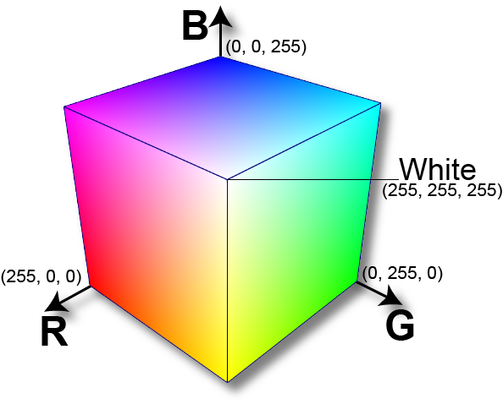
The corner of RGB color cube that is at the origin of the coordinate system corresponds to black, whereas the corner of the cube that is diagonally opposite to the origin represents white. The diagonal line connecting black and white corresponds to all the gray colors between black and white, which is also known as gray axis.
In the RGB color model, an arbitrary color within the cubic color space can be specified by its color coordinates: (r, g, b).
Example:
(0, 0, 0) for black, (1, 1, 1) for white,
(1, 1, 0) for yellow, (0.7, 0.7, 0.7) for gray

Slide 6
Color specification using the RGB model is an additive process. We begin with black and add on the appropriate primary components to yield a desired color. The concept RGB color model is used in Display monitor. On the other hand, there is a complementary color model known as CMY color model. The CMY color model use a subtraction process and this concept is used in the printer.
In CMY model, we begin with white and take away the appropriate primary components to yield a desired color.
Example:
If we subtract red from white, what remains consists of green and blue which is cyan. The coordinate system of CMY model use the three primaries’ complementary colors:
C(cray), M(magenta) and Y(yellow)

Slide 7
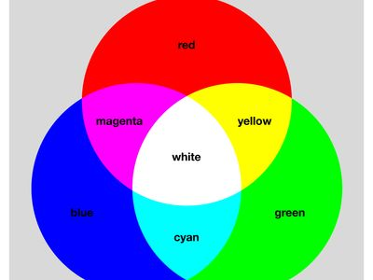
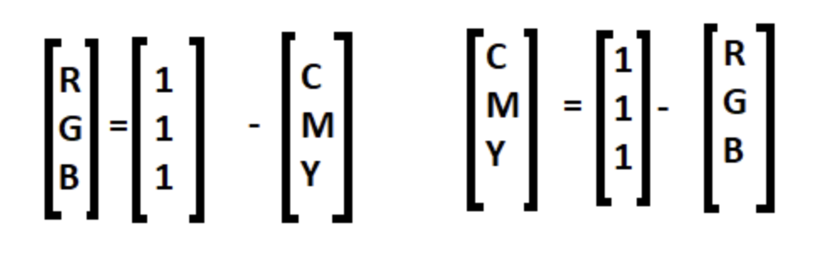
Conversion
The corner of the CMY color cube that is at (0, 0, 0) corresponds to white, whereas the corner of the cube that is at (1, 1, 1) represents black. The following formulas summarize the conversion between the two colour models:

Slide 8
INSIGHTS
START

Slide 9
ADVANTAGES
Ideal for digital displays: Matches how screens emit light.
Wide color range: Capable of producing millions of colors.
Simple to implement in software and hardware.
Additive nature: Easy to combine light to get desired colors.
Compatible with most image file formats (JPEG, PNG, BMP, etc.).

Slide 10
DISADVANTAGES
Device-dependent: RGB values may vary between devices.
Not suitable for print media (needs conversion to CMYK).
Less intuitive for human understanding and color adjustment.
Doesn’t represent perceptual uniformity (small RGB changes ≠ noticeable color changes).
Can be inefficient for color correction and scientific color analysis.

Slide 11
APPLICATIONS
Used in digital screens: TVs, monitors, smartphones, tablets.
Web design and development (HTML/CSS colors use RGB).
Computer graphics and image editing software (e.g., Photoshop).
Video games and animation rendering.
Digital cameras and scanners for image capture.

Slide 12

Feature | RGB | CMYK | HSV (HSB) | LAB
Full Form | Red, Green, Blue | Cyan, Magenta, Yellow, Black | Hue, Saturation, Value | Lightness, a (green–red), b (blue–yellow)
Used In | Digital displays, screens | Printing (ink-based) | Color picking, UI design | Image processing, color difference analysis
Color Space Type | Additive | Subtractive | Cylindrical (based on RGB) | Perceptual, device-independent
Primary Colors | Red, Green, Blue | Cyan, Magenta, Yellow | Derived from RGB | Not based on primaries
Range | 0–255 per channel | 0–100% per channel | H: 0–360°, S/V: 0–100% | L: 0–100, a/b: –128 to 127 (approx.)
Mixing Result | Combining all gives white | Combining all gives black | N/A | N/A
Intuitive? | Less intuitive for humans | Somewhat intuitive | More intuitive for color tweaks | Very accurate but not intuitive
Device Dependency | Device-dependent (monitor based) | Device-dependent (printer based) | Derived from RGB → device-dependent | Device-independent
Use Cases | Websites, TV, mobile apps | Posters, magazines, brochures | Graphic tools, sliders in software | Image editing (Photoshop), color science

Slide 13
Conclusion
The Finale

Slide 14
SYNOPSIS
The RGB color space is an additive model that blends Red, Green, and Blue light to produce a wide range of colors, primarily used in digital displays. It powers everything from computer screens and smartphones to digital cameras. While ideal for light-emitting devices, RGB is device-dependent and not perceptually uniform, making it less suitable for print or precise color adjustments. Nonetheless, it remains essential in digital imaging and design workflows.

Slide 15
THANKS FOR WATCHING
By
Amritha L
2023510051
B.Tech Artificial Intelligence and Data Science (4/8)
Anna University –MIT Campus

